Slide 1
Brainstorming and Prototyping
Batch 13 , Group D
[18/10/2020]

Slide 2
Today’s Presentation
Introduction
Our Brainstorming Session
Our Idea
Our Prototype
Things We Learned

Slide 3
1. Introduction
Brainstorming and Prototyping

Slide 4
Introduction
Today we are going to describe the part of our Design Thinking project .
The Design Thinking challenge is to design a nutrition bar for the government school students in order to increase the attendance rate of the government schools . This assignment is about to design a prototype of the nutrition bar.
At first, we will share the details and process about our brainstorming session. Then we will share our idea and the reasons for this idea to be selected. After that we are going to display the prototype which we had designed regarding our project Finally, we will tell about the things which we have during the assignment discussion.

Slide 5
2. Our Brainstorming Session
Brainstorming and Prototyping

Slide 6
Our Process
details of your brainstorming process
•17th October we held our brainstorming session
•9 members of our group are involved in brain storming
•We generated new ideas and solutions around the specific domain of interest by removing inhibitions.
•Around 6 ideas we got in our brainstorming session
•We evaluated bases on need of public and for 90%approval rating of AP state

Slide 7

3. Our Idea
Brainstorming and Prototyping

Slide 8
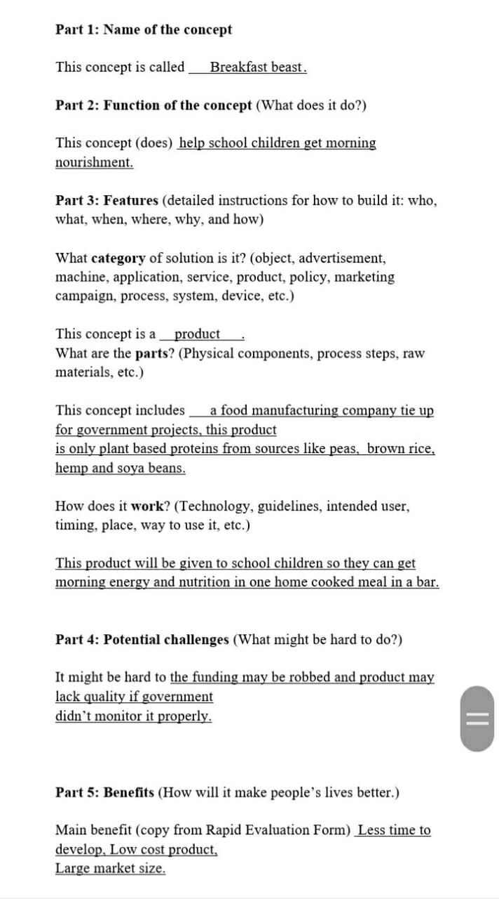
Our Selected Idea
Breakfast Beast
This product will be distributed in all government schools as a morning snack where children can start the day with
Full stomach and will active in class.
This will also increase the attendance rate and enrollment into the school.
Which will help many children to be nourished and educated.

Slide 9
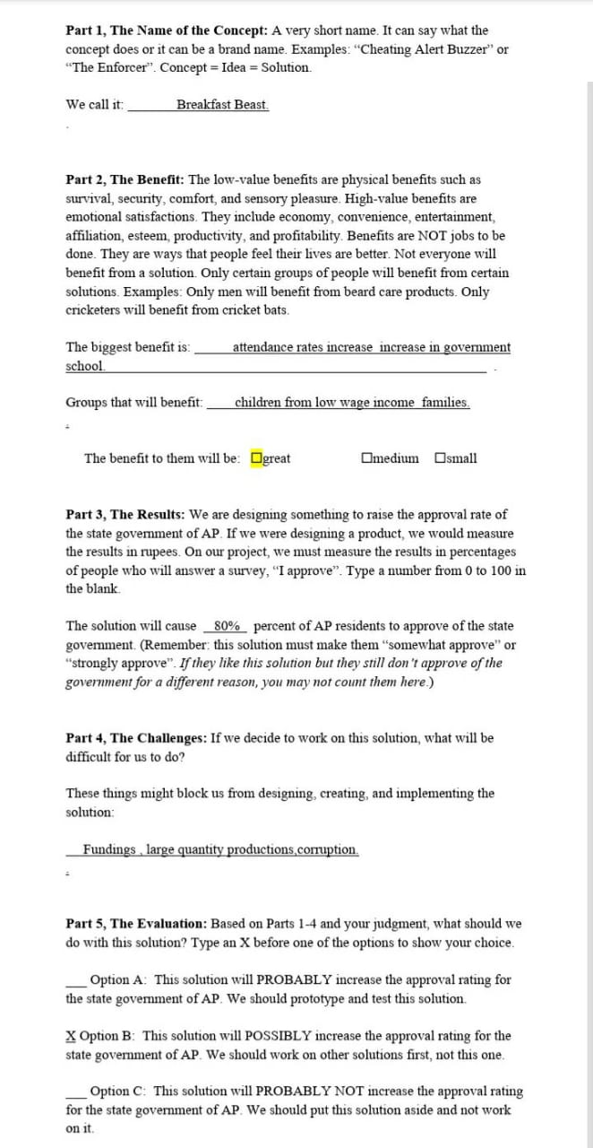
Our Justification
Our Rapid Estimation Form Contains the name of the concept "Breakfast Beast" and it also contains the benefits of our projects and also contains the percentage of approval rating that government can gain and finally it contains the challenges of our project.
We think it is the best idea because
1)Basis in evidence 2)Largest market size 3)Least time to develop 4)Lowest cost to develop

Slide 10
4. Our Prototype
Brainstorming and Prototyping

Slide 11
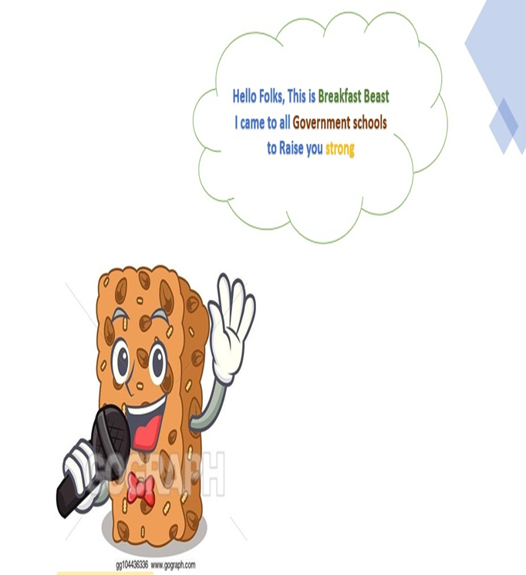
Our Concept Prototype
We evaluated all the ideas and came up with this idea coz this have more approval chances by the govt
Dhanya, Varalakshmi, Veena chowdary, Tarun, Chandrasekhar ,pavan kumar participated in prototype design.
Dhanya ,Varalakshmi ,Veena chowdary, Tarun , Chandrasekhar, Pavan kumar ideas were taken and evaluated.
Benefits of the prototype
delicious and sustainable
Increase in 90 % of their attendance
when compared to their empty stomach they can eat nutritious food and well concentrated on their studies

Slide 12

5. Things We Learned
Brainstorming and Prototyping

Slide 13
Lessons Learned
Brainstorming:
When we are discussing about our project we came to know some problems are facing by government
students in nutrition food and we came to know how to find the solutions for them.
The students of govt. was not getting a good nutrition food(quality and quantity) due to the people who are their in b/w the students and govt. and we came up a solution that the govt. show give the money to the mother not to an father. In the family the father may or may not good but not the mother.
Improve nutrition education to enable better lifelong dietary habits. Nutrition education starts at home, continues in school, and should be reinforced by public communication campaigns.
Invest in the modernization of infrastructure and transport chains to reduce food and nutrient losses and improve food safety, especially in rural areas.
Prototype:
Prototyping is an experimental process where design teams implement ideas into tangible forms from paper to
digital. Teams build prototypes of varying degrees of fidelity to capture design concepts and test on users. With
prototypes, you can refine and validate your designs so your brand can release the right products.

Slide 14

THANK YOU!

